Slide 1
Analysis of Health,Military and Education Data
DATS 6401 - Data Visualization-Individual Project 1
TejaswiniVuppu

Slide 2
Overview of Data
Data was taken from SIPRI Military Expenditure Database and World Bank
Charts used to display data are Stack charts,Pie charts,Column charts and Bar charts.
Years data ranges from 2009 to 2014.
Countries participated in G-20 are used.
Cleaned data using Python(Jupyter notebook sheet) and Excel.
Choose all countries in relation with health,education and military data.
Javascript,Html,Bootstrap and Google API are used for visualization process.

Slide 3
Goals
The educational, healthcare, and military spending of at least the top 10 nations
Compare the spending data to that country’s GDP
Compare the education and health to the overall military spending of the country
Compare the per person educational spending to the per person GDP
Compare the per person healthcare spending to the per person GDP
Compare the per person military spending to the per person GDP
Fastest growing countries in healthcare and educational spending in fixed value and in percentage

Slide 4
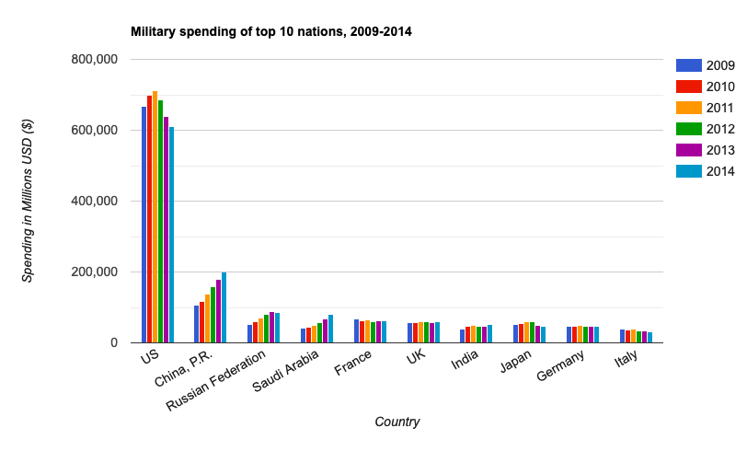
The educational, healthcare, and military spending of at least the top 10 nations.
These charts shows the trend of
military,health and education
spending in USA has increased and
there is no where a comparison
with other countries.
Rest other countries didn’t show
that constantly,they keeps on changing
its position based on health,education
and military data.
in bTheehTheaTheviours

Slide 5
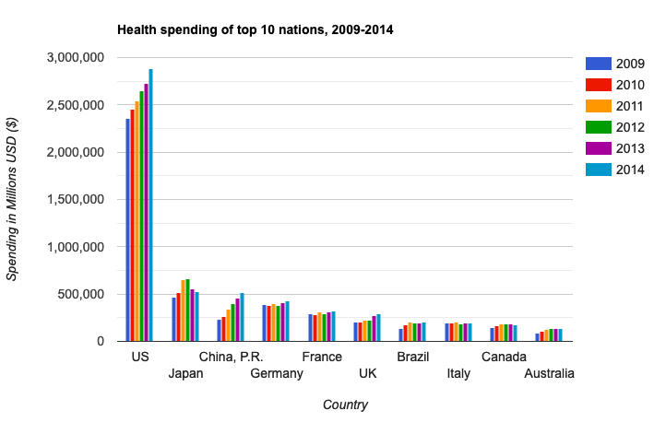
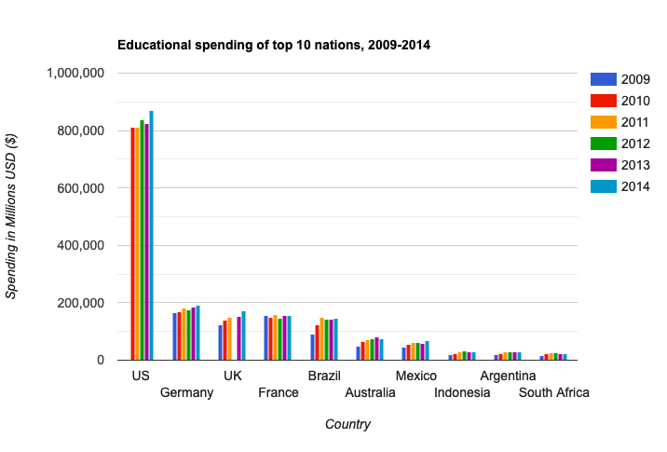
The educational, healthcare, and military spending of at least the top 10 nations(Continuation)

Slide 6
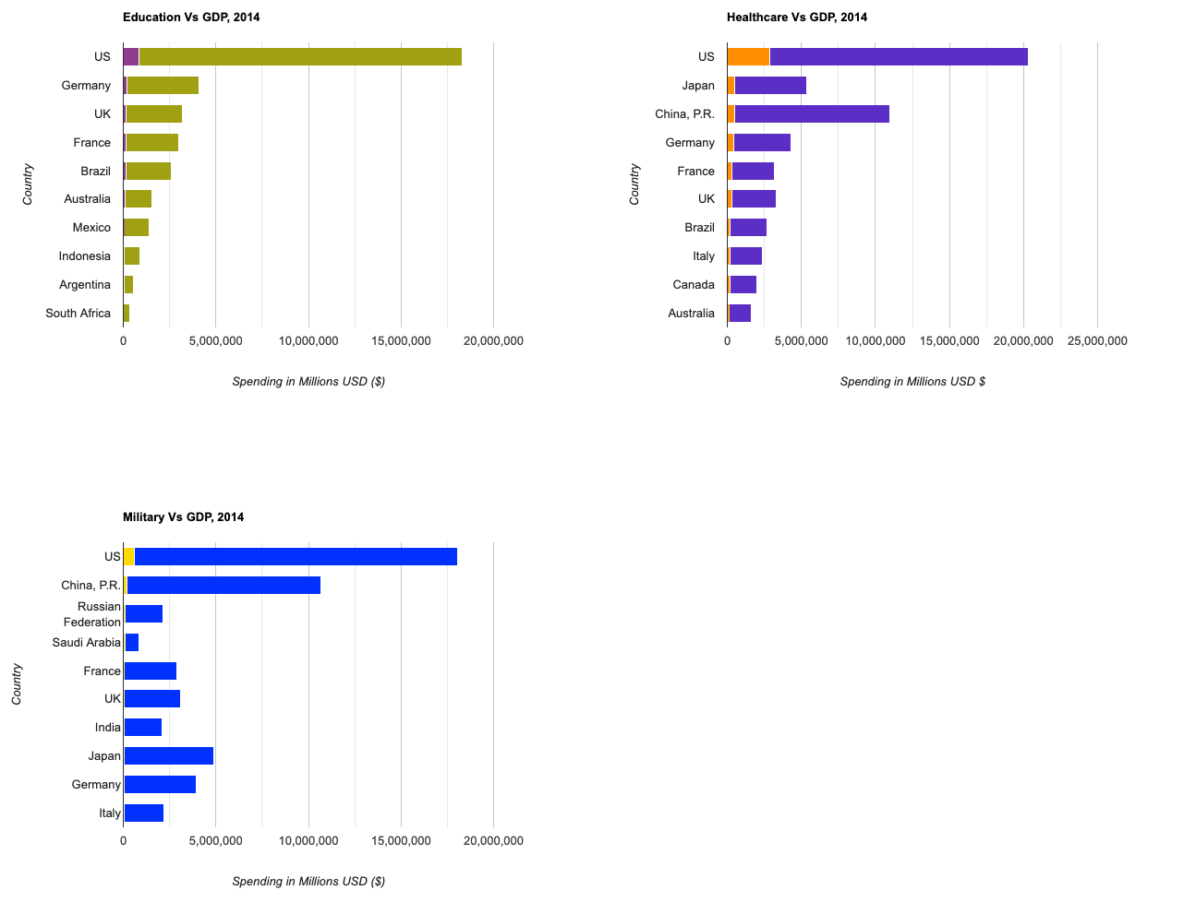
Compare the spending data to that country’s GDP

Slide 7
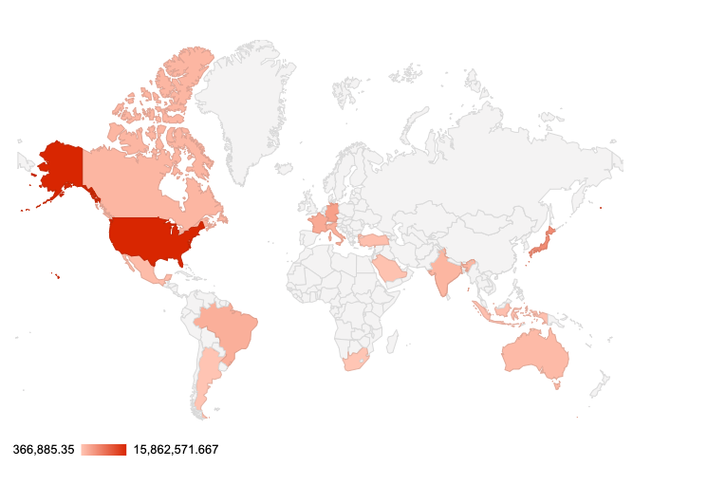
Compare the spending data to that country’s GDP
Above slide gives information
about the Education,Health
and Military vs GDP
for all the countries.
Among them in all the cases
United states is kept at the top
position and rest all countries
do not maintain consistency.
Geomaps explain about the
Education Spending of countries
with respect to GDP by using
Geomaps.

Slide 8
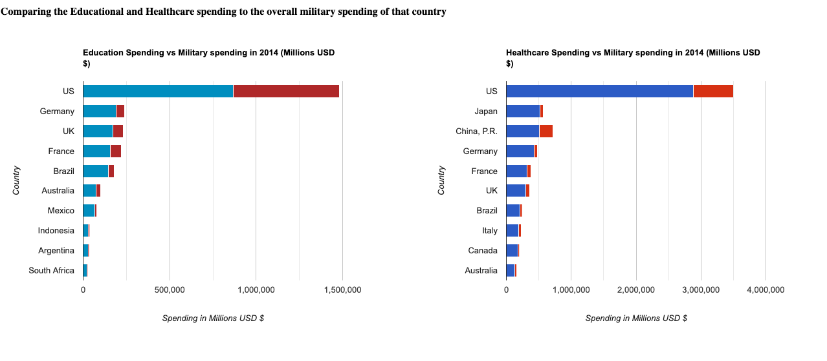
Compare the education and health to the overall military spending of the country

Slide 9
Compare the education and health to the overall military spending of the country(Continuation)
When we compare the education and health care data with respect to education data ,we see United states stay top in both the bar charts that are displayed in above slide.
Having being taken values in million usd dollars also the data doesn’t get changed.
And money spend on all the resources like health,education and military
we say united states stay first.

Slide 10
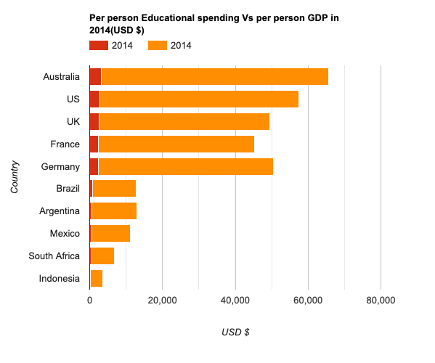
Compare the per person educational spending to the per person GDP
When we look at the bar chart Australia
looks top this time,before all the scenarios
United States occupies first place.
This means Australia spends more
amount for education eventhough there
GDP is less compared with United states.
That is reason why Australia stays top.

Slide 11
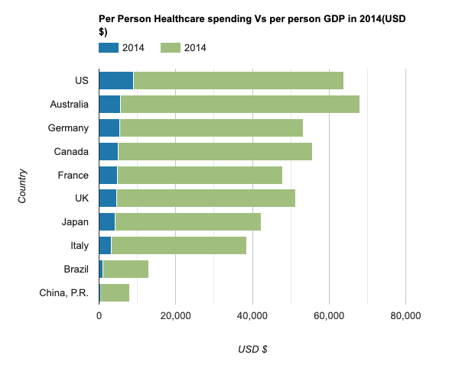
Compare the per person healthcare spending to the per person GDP
If we take the data for 2014,
according to survey United states
spends more money on
Health care with respect to
person GDP.
I appreciate this country as health
is important rest all things
can be done peacefully.
Without health support not
even single thing can be done.
Though Australia has per person
GDP the more they won’t spend
more money on health like
United States.

Slide 12
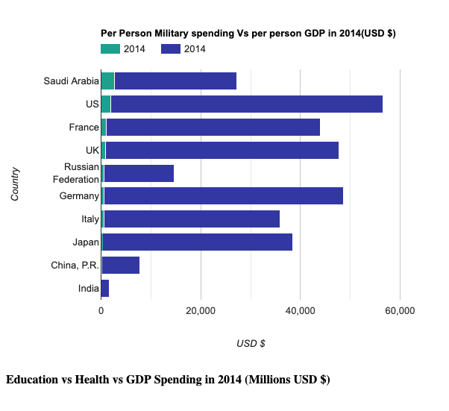
Compare the per person military spending to the per person GDP
In this barchart we see Saudi
Arabia spends more money
on military spending
when compared with
other countries.
Though the economy of
United states and GDP was
more .United states stays in
second position followed
by Saudi Arabia.

Slide 13
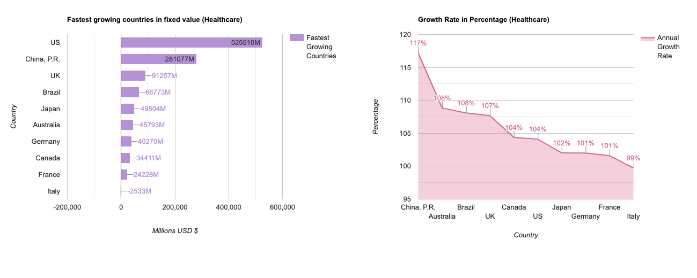
Fastest growing countries in healthcare and educational spending in fixed value and in percentage

Slide 14
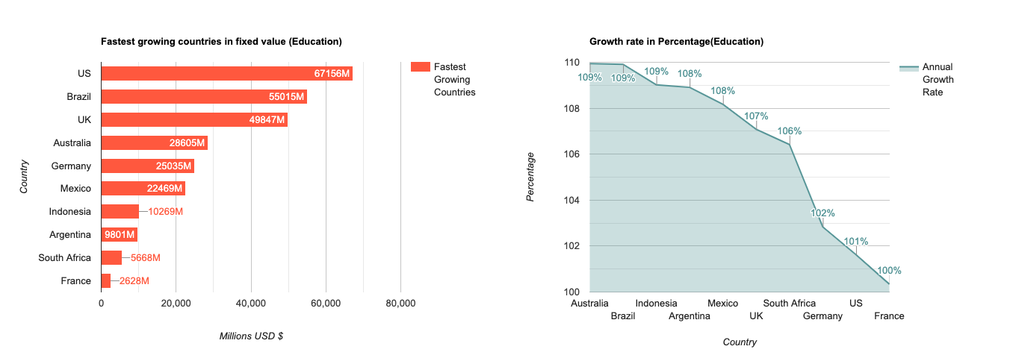
Fastest growing countries in healthcare and educational spending in fixed value and in percentage(Continuation)

Slide 15
Fastest growing countries in healthcare and educational spending in fixed value and in percentage(Continuation)
This is for Health care data,
Above chart explains the fastest growing country in fixed value in relation to
health care is United States .
And fastest growing country in percentage for health care data is China.
For Education data,
Above charts explains the fastest growing country in fixed value in relation to
education is United States
And fastest growing country in percentage for education data is Australia.

Slide 16
Conclusion
Among the health,education and military USA stays top from years 2009-2014 with highest GDP of 16,473 Billion US dollars
Fastest growing country in education Brazil ranks the highest with 5.99 percent of total GDP when compared with fixed value it is United states then it is followed by Brazil and UK.
Percentage Spending on Health care United states ranks highest with 17.1 percent of total GDP.
China stays top in fastest growing countries with respect to health care percentage.

